Slide 1

COVID-19 DATA ANALYSIS
By Amulya and Vinutha

Slide 2
PROJECT OVERVIEW
Objective:
The objective of this project is to analyze COVID-19 data using Python to:
Track the spread of the virus
Visualize data effectively
Track vaccinated and unvaccinated rates

Slide 3
DATA COLLECTION
DATA SOURCE
Kaggle

Slide 4
DATA PREPROCESSING
Ensure the data is accurate ,consistent and scaled properly to improve model performance
Handling Missing Values
Duplicates Removal
Normalization and Scaling

Slide 5
Tools and Technologies
Programming Language: Python
Libraries: Pandas, NumPy, Matplotlib, Seaborn,
Data Source: Dataset from Kaggle.
IDE: Jupyter Notebook or Google Colab

Slide 6
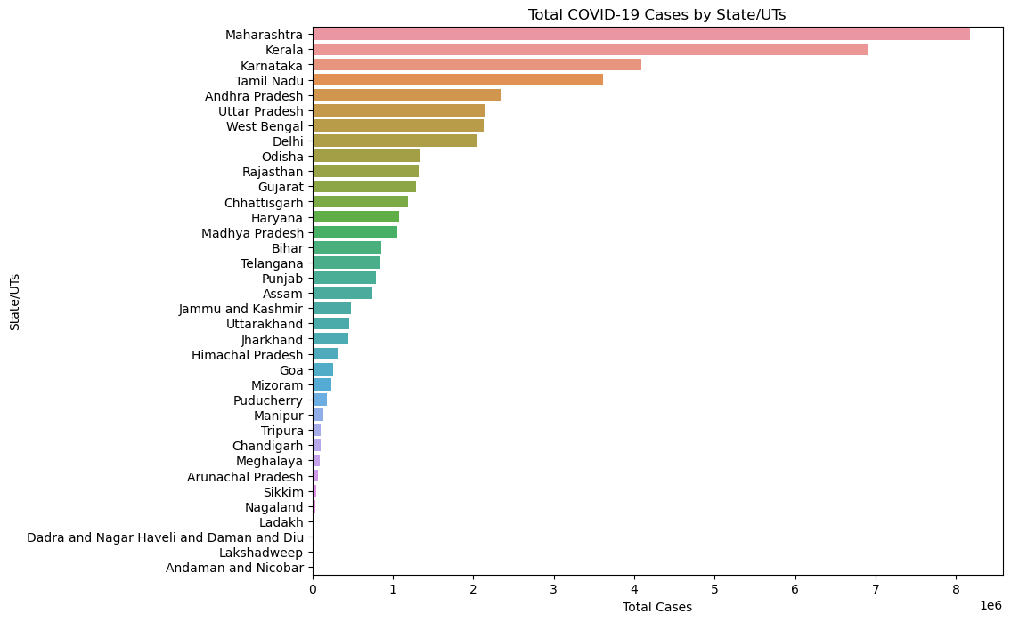
COVID-19 CASES REPORT IN EACH STATE

Slide 7
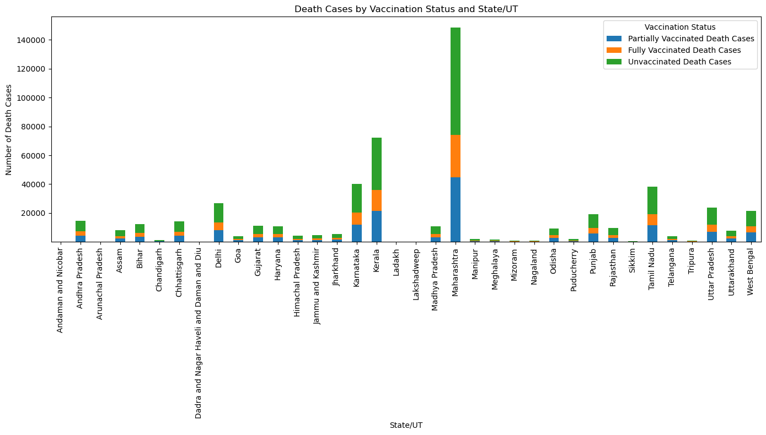
VACCINATION STATUS OF EACH STATE OF INDIA

Slide 8
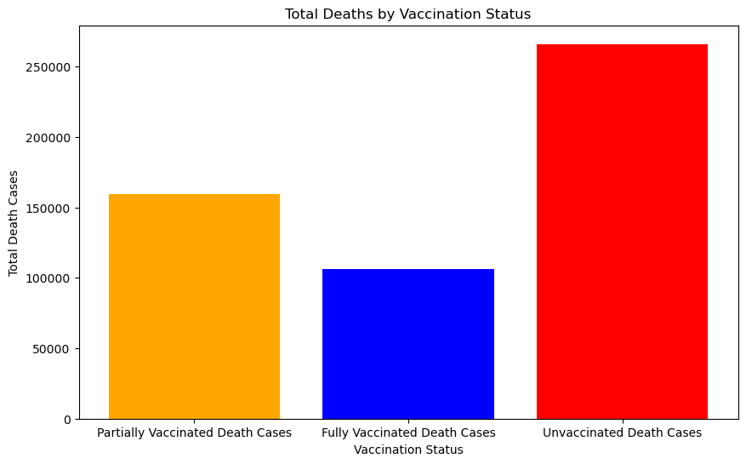
VACCINATION DEATH CASE STATUS

Slide 9
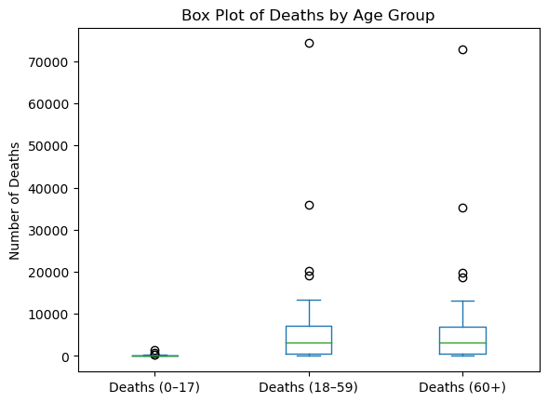
DEATHS BY AGE GROUP

Slide 10
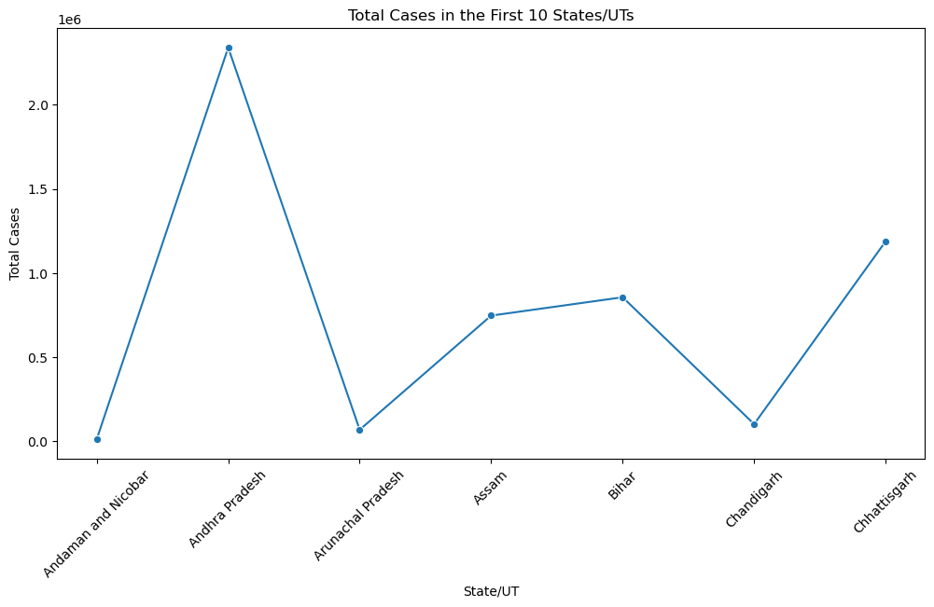
TOTAL CASES IN FIRST SEVEN STATES

Slide 11
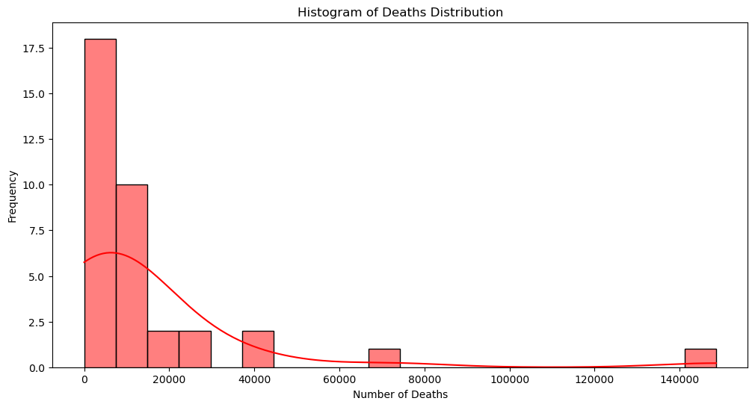
DISTRIBUTION OF DEATHS

Slide 12
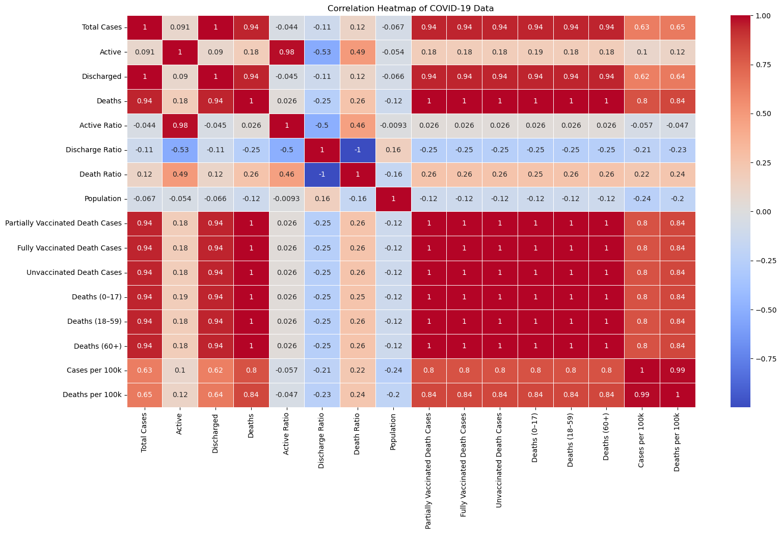
CORRELATION HEATMAP

Slide 13
MODEL BUILDING
Linear Regression:
mean absolute error= 3.952174461072005e-05
Random Forest Regressor:
mean absolute error=0.0008974832150714975

Slide 14
THANK YOU!!!

